Slide 1
Beyond Lithium; The next generation Aircraft Battery Chemistry
Safer - Lightweight - Dependable
Evaluating a safer powerful alternative to current lithium tech

Slide 2
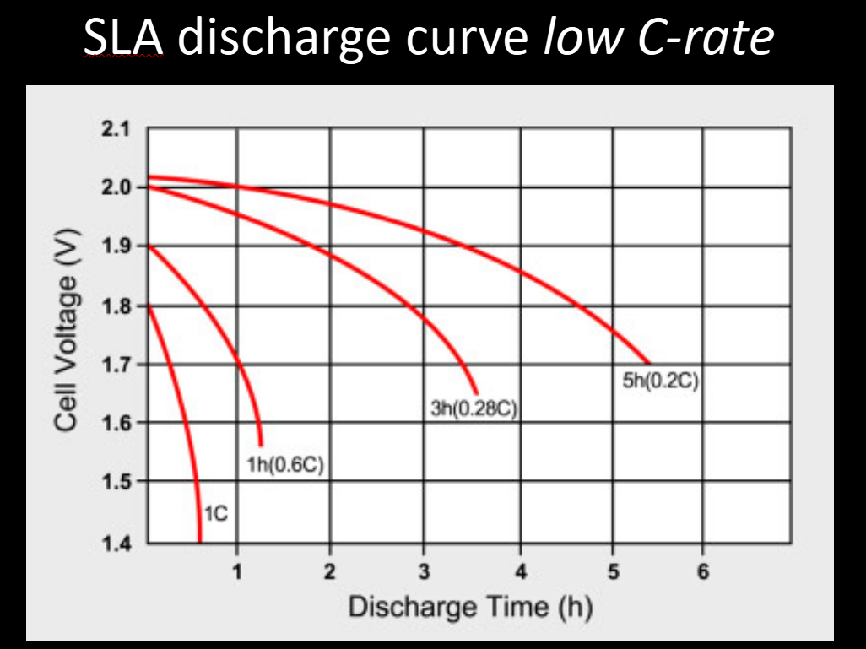
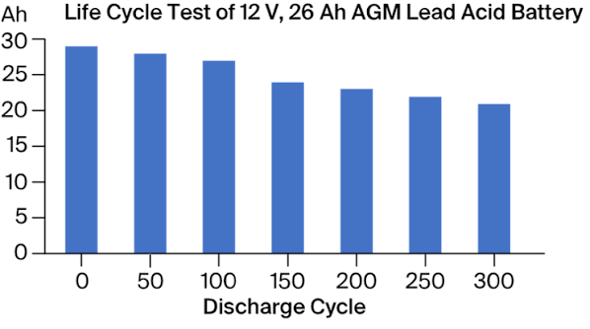
Lead/AGM vs Lithium/LiFepo4 vs Sodium/Na4Fe3PO4
1st, lets talk Lead: very heavy, short lifespan if not perfectly maintained, low energy density, large V drop on engine cranking, especially w turbines, especially at freezing temps, greater IR, sulphates if left not fully charged, not enviro friendly.

Slide 3
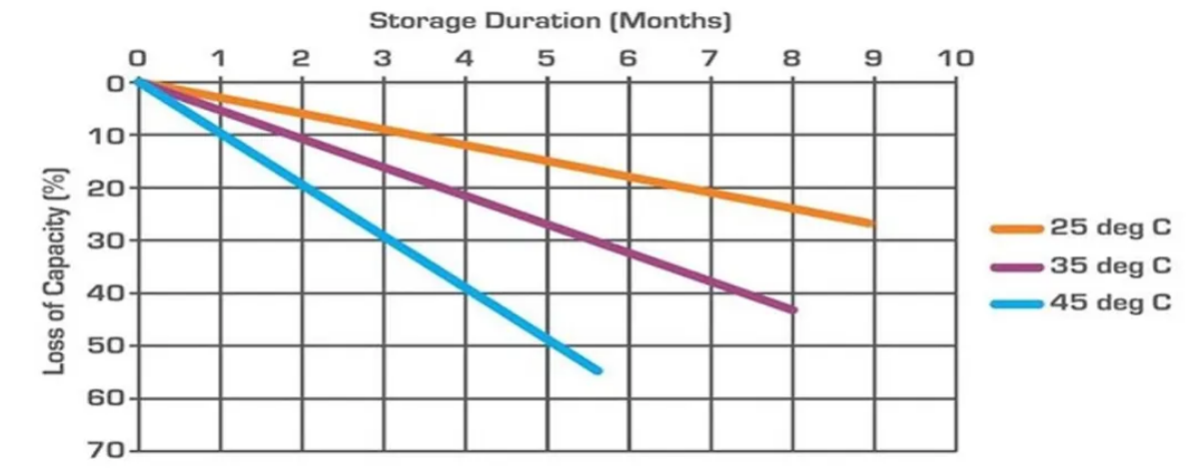
Lead storage

Slide 4
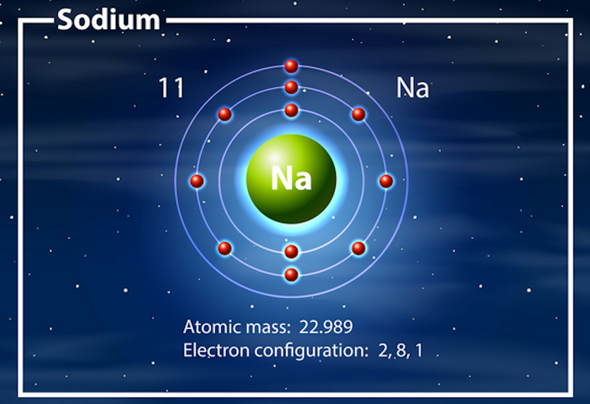
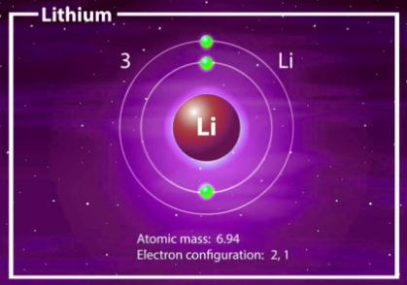
SODIUM vs LITHIUM the important comparison

Slide 5
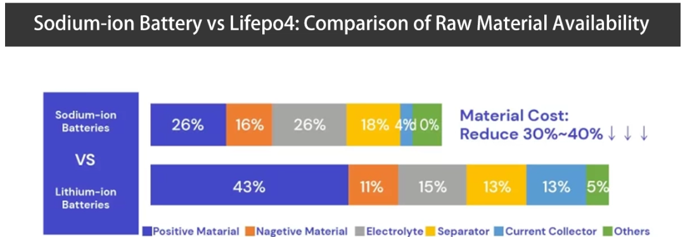
% of raw materials used

Slide 6
Vulnerabilities to using a lithium battery
The BMS on a popular lithium battery shuts off at 11.5V.
Permanent damage from a single deep discharge,
Small but measurable risk from thermal runaway, Lots of smoke.
Fault light warning system is too generic and open to interpretation
Venting requirement for inside cabin use
Poor performance in cold temperatures
Charger compatibility restrictions force owners to buy companies expensive compatible chargers

Slide 7
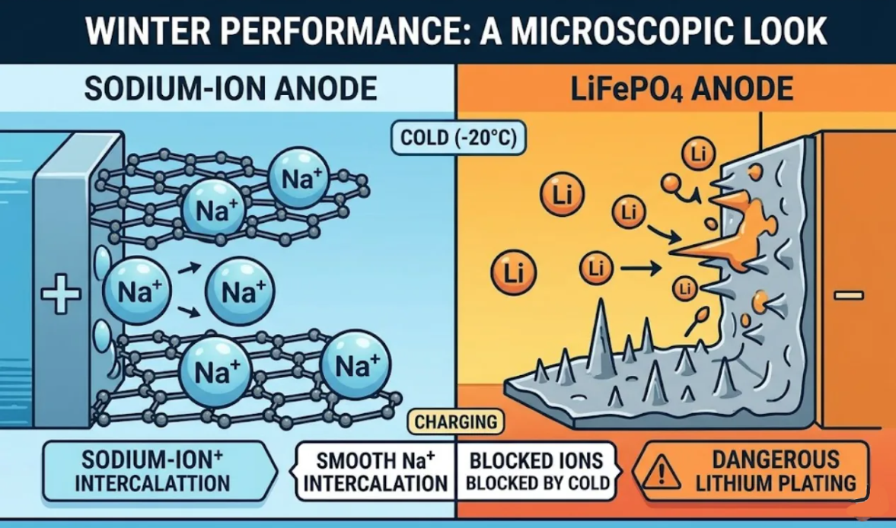
COLD TEMPERATURE IMPACT !!

Slide 8
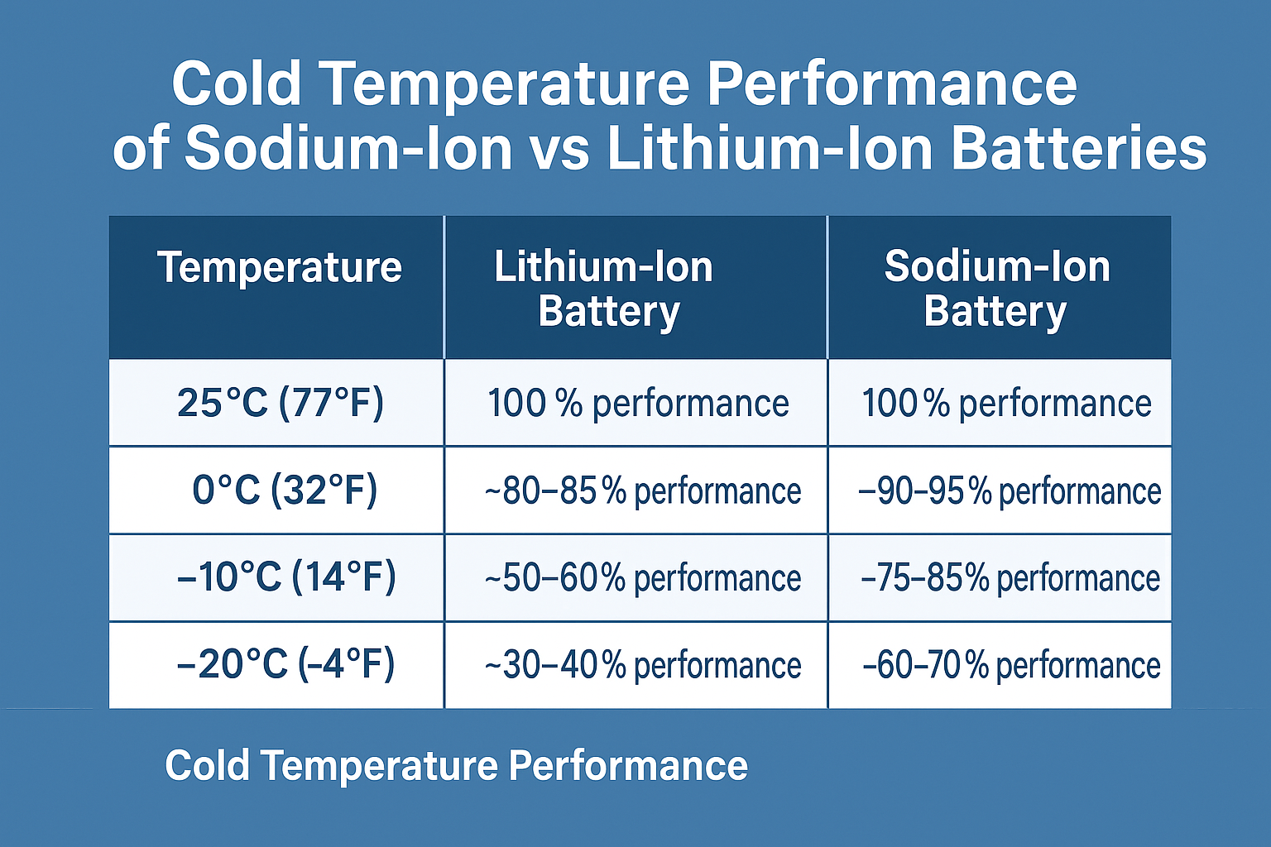

Slide 9
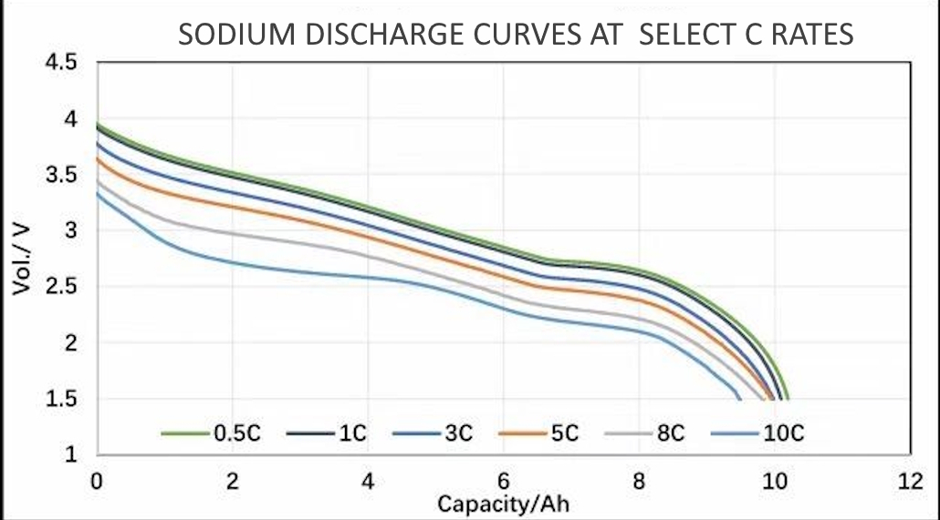
Easier to determine SOC with linear sloping curve

Slide 10
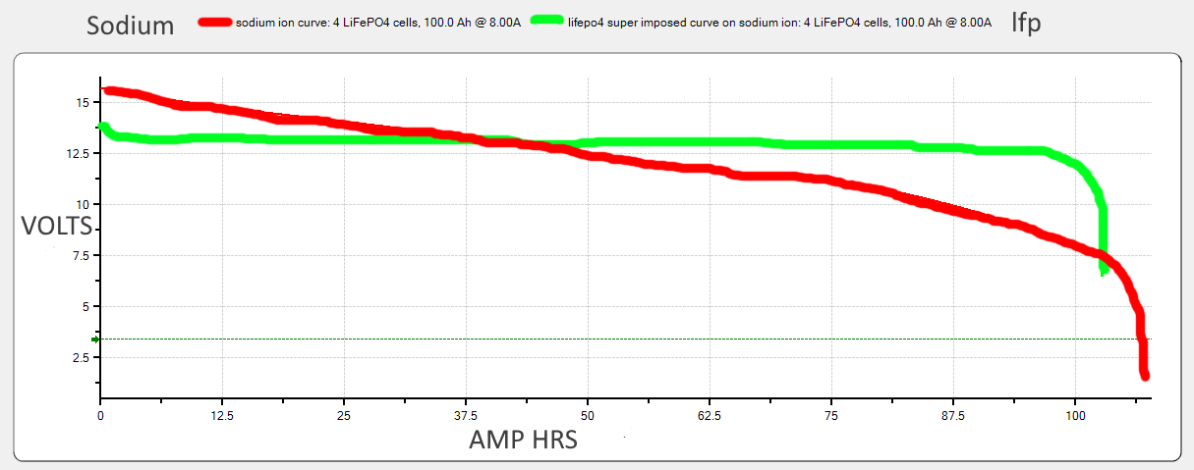
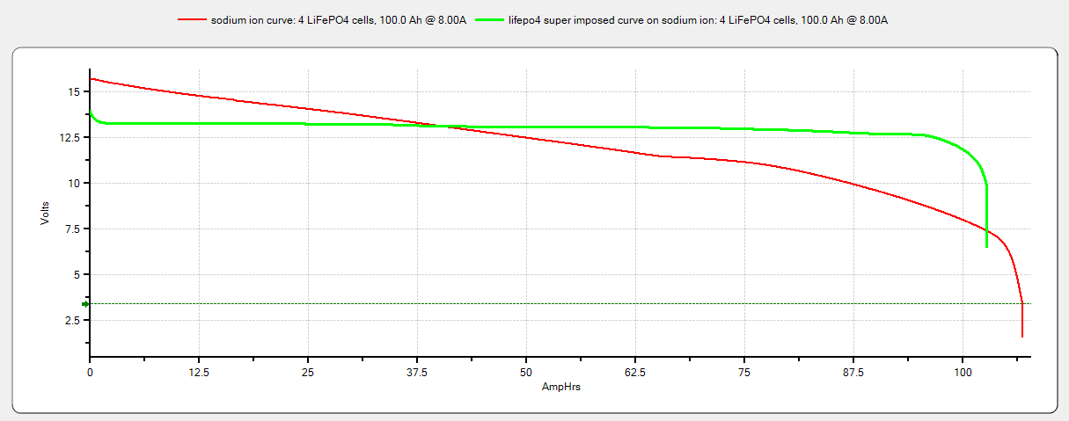
LiFepo4 vs Sodium discharge curves

Slide 11
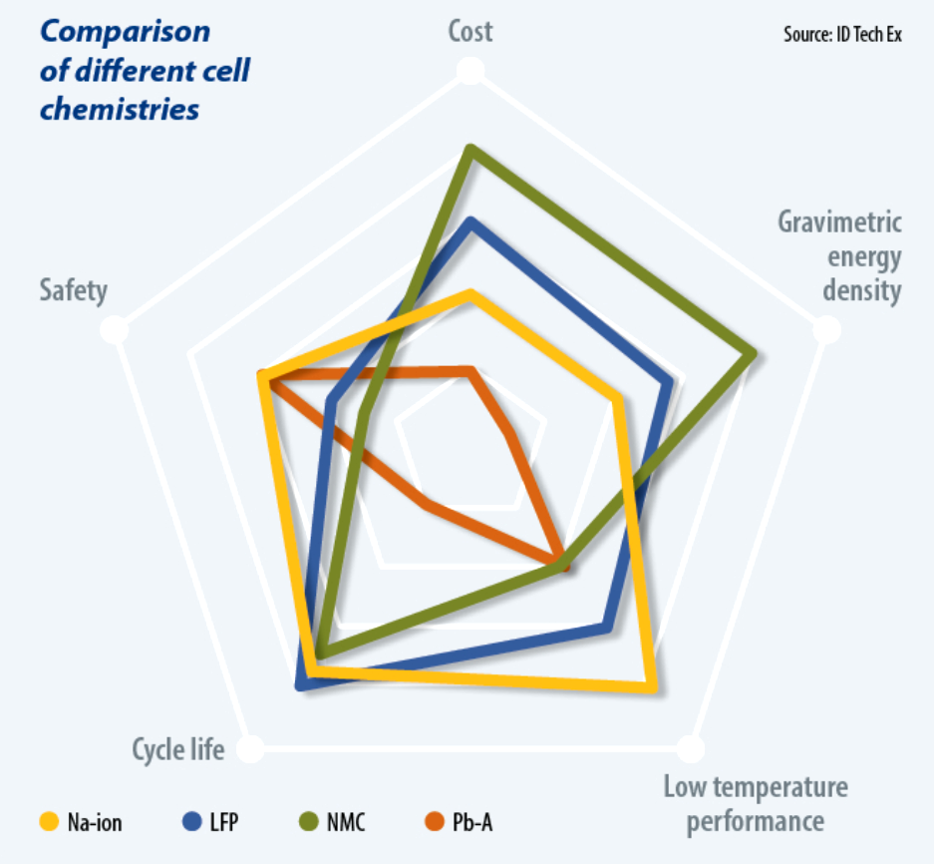
Lead LFP Sodium comparison

Slide 12
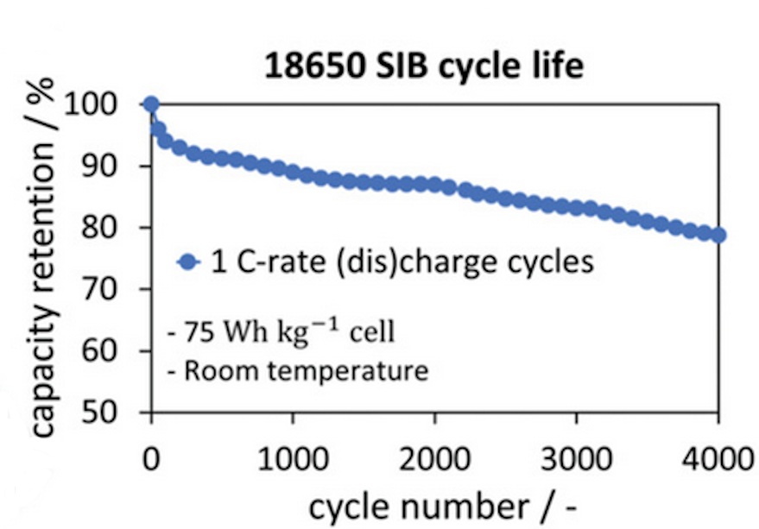
Sodium Life Cycles

Slide 13
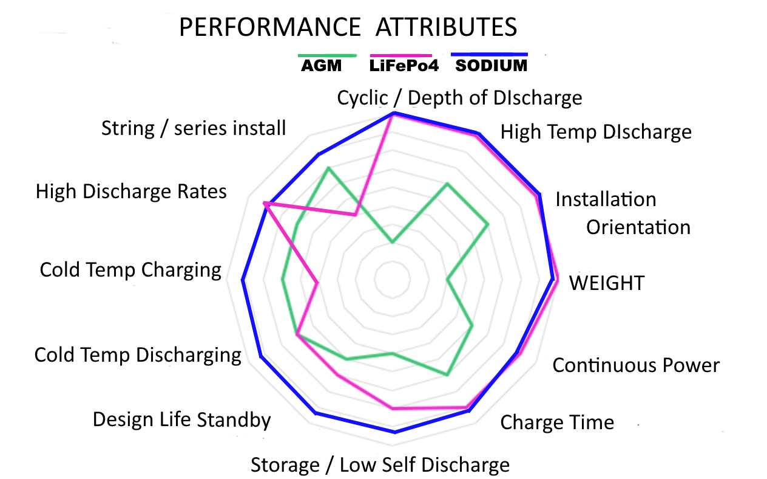

Slide 14
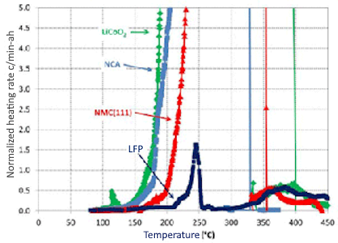

Slide 15
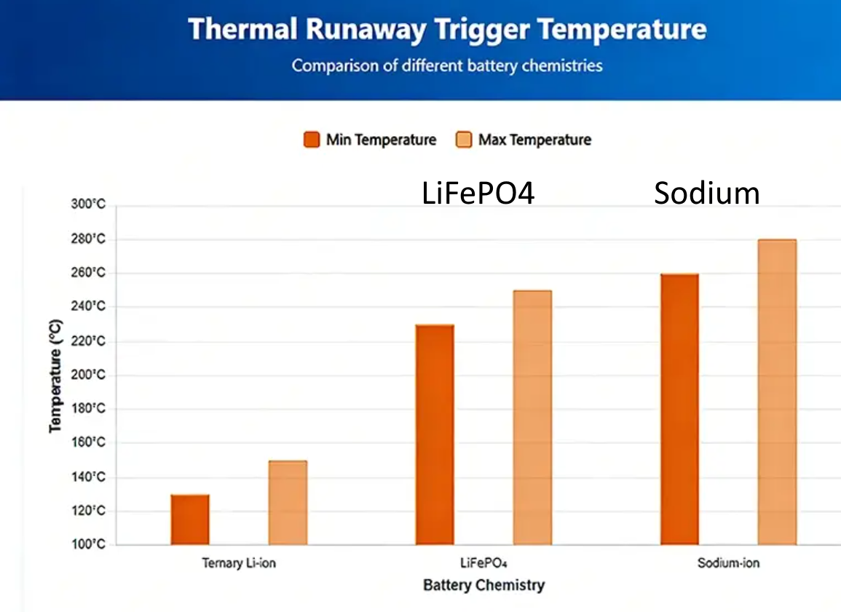

Slide 16
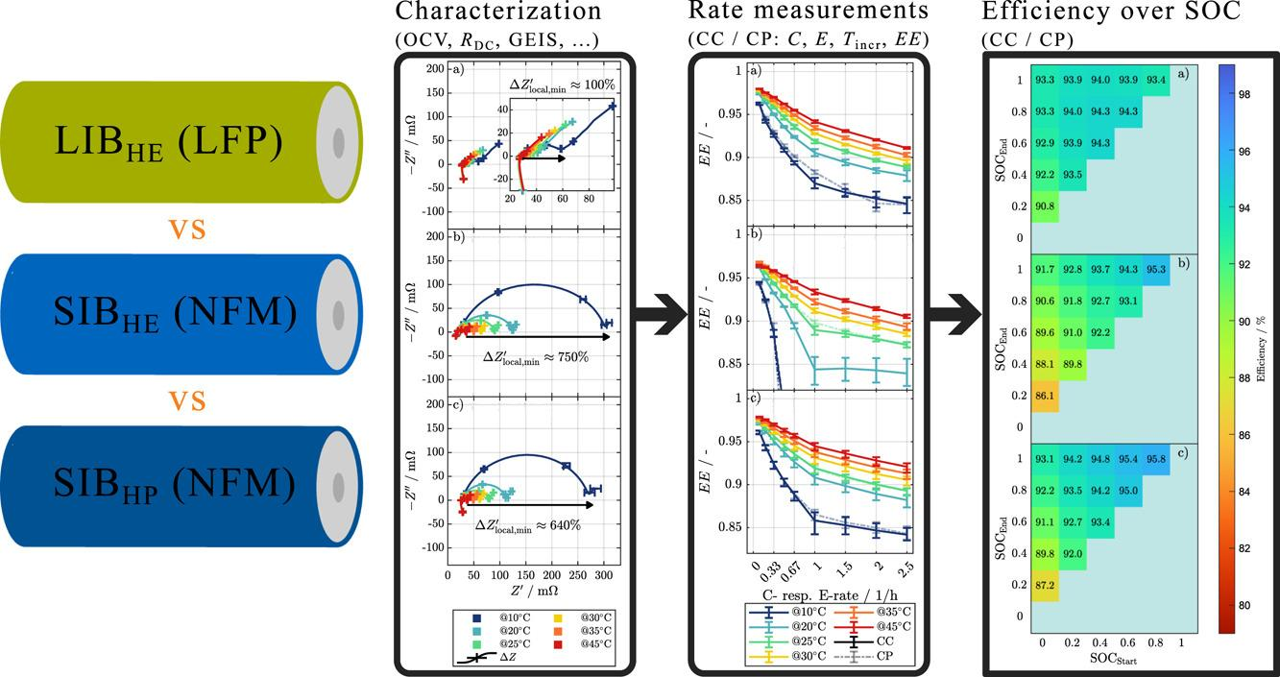

Slide 17
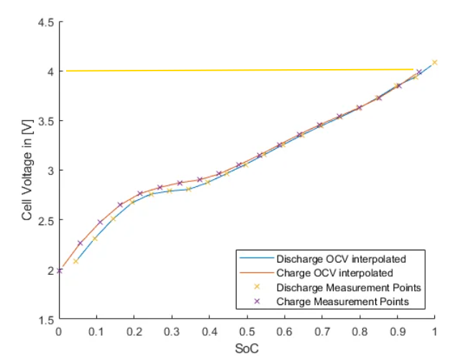

Slide 18
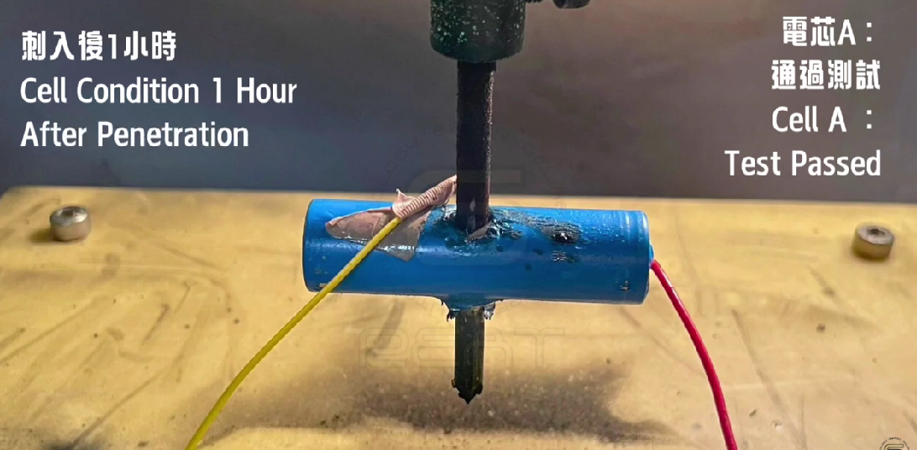

Slide 19
State of Charge (%) | Effect on Battery Performance
120 | Little degradation observed
130 | Significant irreversible loss of sodium inventory
140 and above | Significant capacity degradation Implications of Overcharging 120% SOC: At this level, sodium-ion cells maintain their performance with minimal degradation. 4.8V cell / 19.2V 130% SOC: The cells begin to experience notable damage, particularly in the form of irreversible loss of sodium, which can affect overall battery life and efficiency. 5.2V cell / 20.8V 140% SOC and beyond: At this point, the cells face substantial capacity degradation, which can severely limit their usability and lifespan

Slide 20
LiFepo4 overcharge
3.40V - 3.45VFull / RestingThe cell's resting voltage at 100% capacity after sitting for 15-30 minutes.3.55V - 3.65V Maximum Safe Recommended ceiling limit for charger termination. Current tapers off.3.65V - 4.00V Mild Overcharge - Voltage spikes rapidly. Accelerated wear on the cathode structure.4.00V - 4.20V+Severe Overcharge Electrolyte oxidizes, generating gas and causing cell swelling or venting.

Slide 21
SUMMARY
SODIUM ENGINE STARTING ATTRIBUTES:
SUPERIOR COLD WX PERFORMANCE
HIGH CURRENT CAPABILITY, VERY LOW IMPEDANCE
ABSOLUTE SAFETY, EXCELLENT THERMAL STABILITY
ZERO VOLTAGE DISCHARGE
FAST CHARGING
LONG CYCLE LIFE
LESS COMPLICATED - NO BMS NEEDED
LOWER COST

Slide 22
One final thought.. If extreme cold temp starting is important and a battery that will last a lifetime, and a little more weight and size are not a restriction, that is also available. Called LTO

Slide 23
Now , lets look at LTO
For applications requiring reliable engine starting in extreme low-temperature environments and exceptional service life, Lithium Titanate (LTO) battery technology is also available. Although LTO batteries are larger and heavier than other chemistries, they provide outstanding low-temperature performance, extremely long cycle life, and high power capability, making them well suited for demanding aviation applications where weight and size are not the primary design constraints

Slide 24
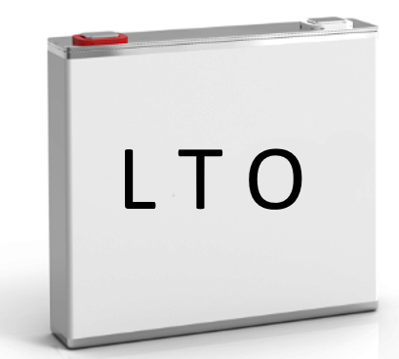

Slide 25
LTO vs LiFePO4
Energy Density - Low 80 wh/kg higher 160wh/kg
Cycle Life 20,000 depending on discharge 2 - 4000
Charging TIme ULTRA FAST FAST
Nominal voltage 2.4V 3.2V
Thermal Stability Extremely good Very good
Low Temp Perf Stable down to - 30 Slowly degrades < zero c
Safety Very H resist , > chemically stable High resist to overheating
Energy Efficiency 95 to 99% 90 to 95%
Discharge speed Very high High
Life Span up to 20 years up to 6 years

Slide 26
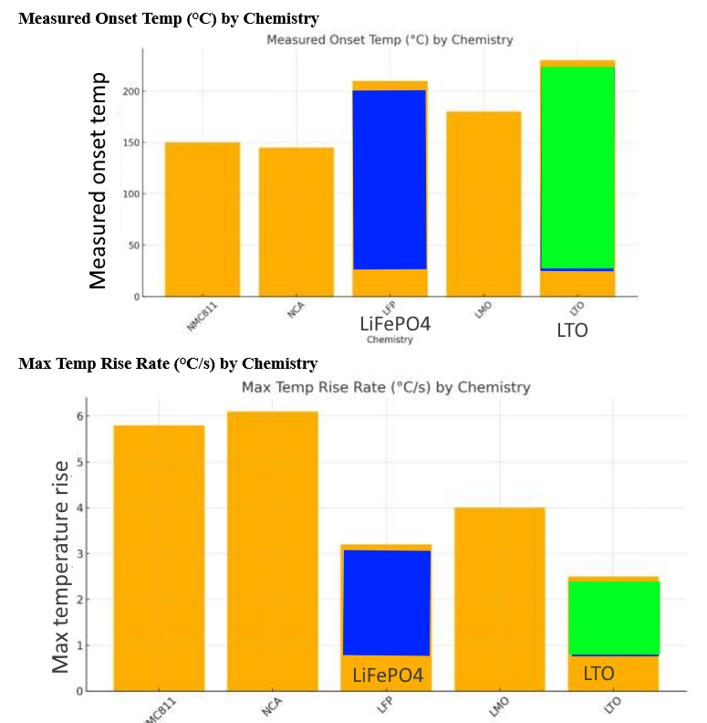

Slide 27
